Slide 1
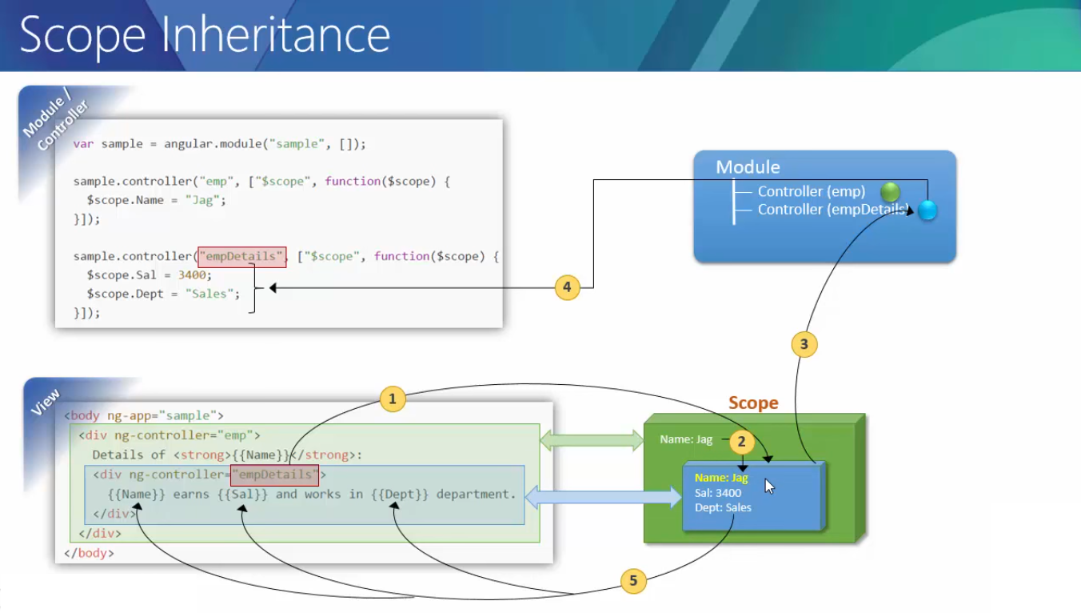

Slide 2
When a particular block is made available to AngularJS it will do the following process
Create a scope object & sits at DOM level
Associate the scope object to the block
Create new instance of controller
Associate the scope itself to the controller
Execute the particular controller code.
Get all the properties and values into the scope object
Then Evaluate the expression against that particular scope object
Whenever inner scope is created all the outer scope related information is mad available to inner scope as well

